Slide 1
Creating a Simple Maven Project

Slide 2
The Game Plan
Learn about Eclipse’s support for Maven
Create a simple Maven Project with Eclipse
Explore the generated files and directories
Run our App
Update the Java version settings
www.luv2code.com

Slide 3
Eclipse and Maven
•
Most recent versions of Eclipse have built-in support for Maven
Use the m2eclipse plugin
•
There is no need to download/install Maven separately
•
Can create Maven projects, add dependencies all inside of Eclipse
www.luv2code.com

Slide 4
Create a WebApp Maven Project

Slide 5

The Game Plan
Create a WebApp Maven Project with Eclipse
Explore the generated files and directories
Add dependencies to our POM file
Run our WebApp
www.luv2code.com

Slide 6
Maven Repositories

Slide 7











Maven - How It Works
Maven Local Repository
Check local repo
(your computer)
Project Config file (pom.xml)
2
Spring Hibernate
Commons Logging
JSON
…
Read config file
4
Save in local repo
1
Maven
Maven Central Repository (remote)
5
developer
Build and Run
3
Get from remote repo
www.luv2code.com

Slide 8
Repository Types
•
Local Repository
•
Central Repository
www.luv2code.com

Slide 9
Local Repository
Located on developer’s computer
MS Windows: c:\Users\<users-home-dir>\.m2\repository
Mac and Linux: ~/.m2/repository
•
Maven will search this local repository first
Before going to Maven Central Repository
Your local cache
www.luv2code.com

Slide 10
Central Repository
•
By default, Maven will search Maven’s Central Repository (remote)
https://repo.maven.apache.org/maven2/
•
Requires an Internet connection
•
Once files are downloaded, they are stored in local repository
www.luv2code.com

Slide 11
Maven Repositories - Additional

Slide 12


Maven - How It Works
Maven Local Repository
Check local repo
(your computer)
Project Config file (pom.xml)
2
Spring Hibernate
Commons Logging
JSON
…
Read config file
4
Save in local repo
1
Maven
Maven Central Repository (remote)
5
developer
Build and Run
3
Get from remote repo
www.luv2code.com

Slide 13

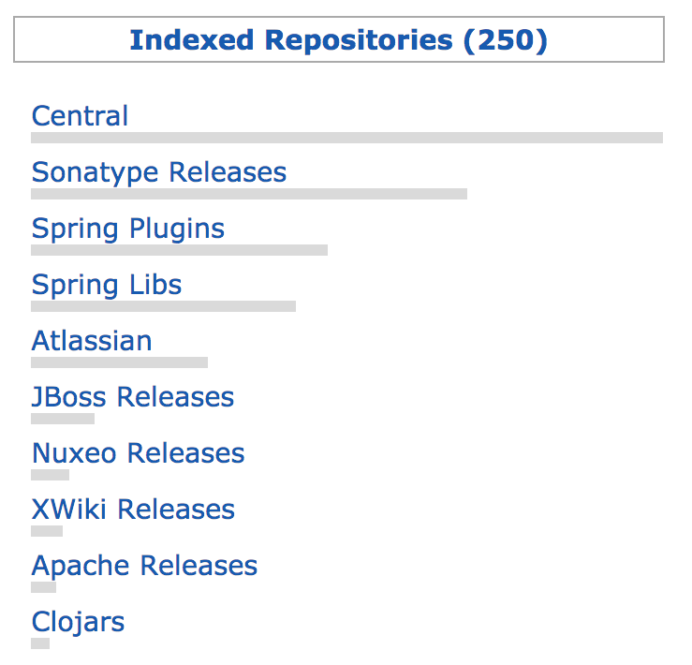
Additional Repositories
Remember how mvnrepository.com can index additional repositories?
www.luv2code.com

Slide 14
Why are there Additional Repositories?
•
Some development teams may self-host their Maven projects / JARs
Alpha/Beta releases
More control over deployments etc
Other reasons …
www.luv2code.com

Slide 15




Accessing Additional Repositories
Maven
www.luv2code.com

Slide 16
Task: Configure Additional Repositories
Step-By-Step
•
Step 1: Add atlassian-mail dependency to our project
This is only available in the Atlassian repository
•
Step 2: Add the Atlassian repository to our pom.xml file
www.luv2code.com

Slide 17

Step 1: Adding atlassian-mail Dependency
File: pom.xml
<dependencies>
<dependency>
<groupId>com.atlassian.mail</groupId>
<artifactId>atlassian-mail</artifactId>
<version>4.0.4</version>
</dependency>
</dependencies>
www.luv2code.com

Slide 18

Step 2: Adding Repositories
File: pom.xml
<repositories>
<repository>
<id>atlassian</id>
<name>Atlassian Repository</name>
<url>https://maven.atlassian.com/content/repositories/atlassian-public/</url>
</repository>
<repository>
…
</repository>
</repositories>
www.luv2code.com

Slide 19
Maven Repositories - Private

Slide 20


Maven - How It Works
Maven Local Repository
Check local repo
(your computer)
Project Config file (pom.xml)
2
Spring Hibernate
Commons Logging
JSON
…
Read config file
4
Save in local repo
1
Maven
Maven Central Repository (remote)
5
developer
Build and Run
3
Get from remote repo
www.luv2code.com

Slide 21
Private Repositories - Use Case
Your company has created super-top-secret code modules
•
Would like to share with other development teams at your company
•
But let’s keep it private
•
NOT AVAILABLE TO THE PUBLIC
www.luv2code.com

Slide 22
Private Maven Repository
•
You can set up your own private Maven Repository
Secure it with credentials: id/password
•
Create your super-top-secret projects and publish on private repository
•
Your development teams can access your private repository
www.luv2code.com

Slide 23
Maven Repository Manager Products
Product | Company | Website
Archiva | Apache | archiva.apache.org
Artifactory | JFrog | www.jfrog.com
Nexus | Sonatype | www.sonatype.com
www.luv2code.com

Slide 24
Cloud Solutions
If you don’t need to self-host internally at your company
•
Cloud hosted solutions are available
•
Check for:
•
www.packagecloud.io, www.mymavenrepo.com
•
Google: maven cloud hosts
www.luv2code.com

